Slide 1

Calibrated Confidence: The Art of Appropriate AI Reliance
When AI Gets It Right, Trust It. When It Doesn't, Catch It.
Fabio Correa | Microsoft Corporation | 2025

Slide 2
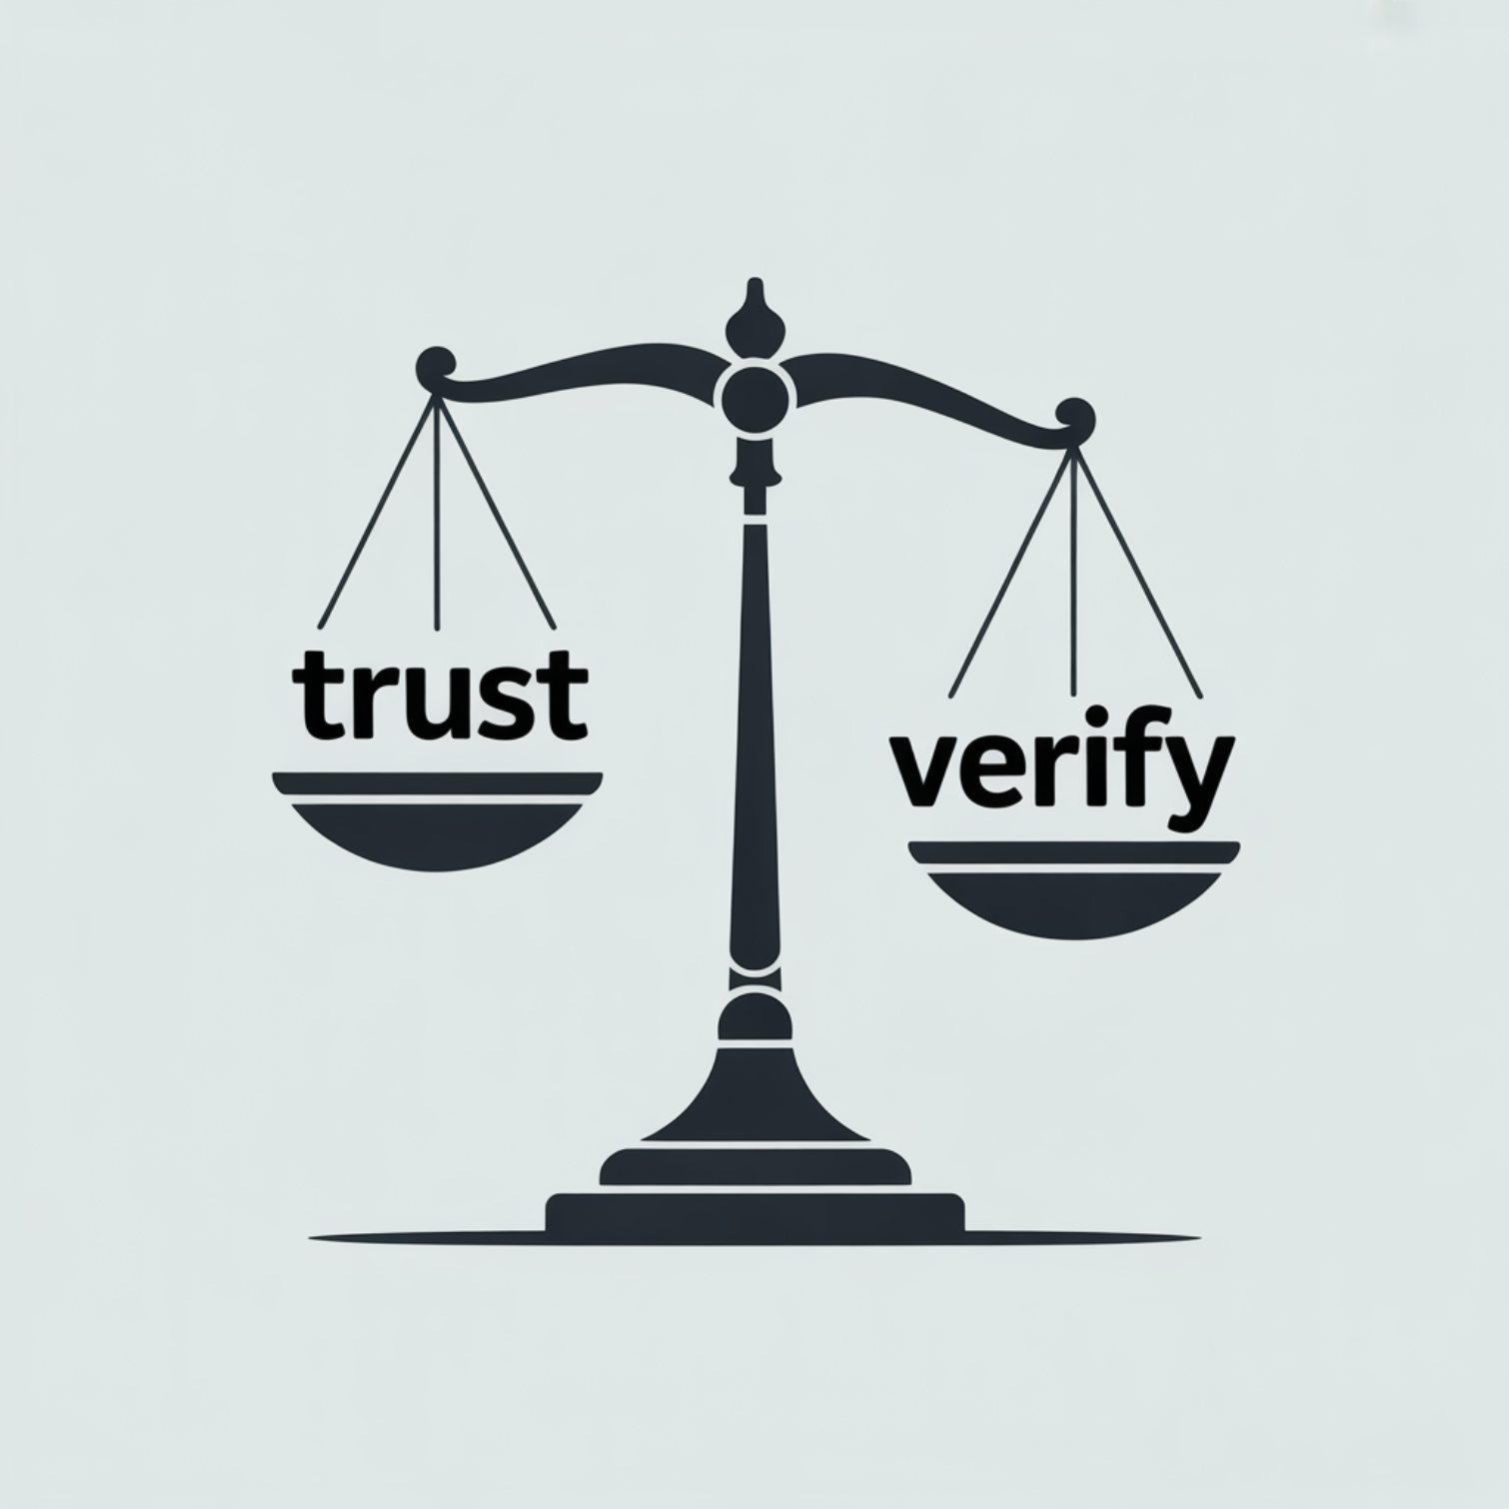
THE CHALLENGE
The Paradox of AI Assistance
The Double-Edged Sword
AI assistants offer remarkable capabilities but create two interrelated dangers that stem from the same root cause: miscalibrated confidence.
Hallucination Risk
AI generates plausible but incorrect information with unwarranted confidence
Over-Reliance Risk
Users accept AI outputs without critical evaluation or verification

Slide 3

DEFINITION
What Is Appropriate Reliance?
Appropriate reliance occurs when users correctly calibrate their trust to match the actual reliability of AI systems. The operative word is "appropriate"—matching trust to reality.
Correct AI-Reliance (CAIR)
Correct Self-Reliance (CSR)
Accept AI outputs when they are correct—capturing the value AI provides
Reject AI outputs when they are incorrect—protecting against errors

Slide 4
The 2×2 Reliance Matrix
Understanding the four possible outcomes when humans interact with AI recommendations helps us identify and maximize appropriate reliance.
✅ CAIR
AI Correct + User Accepts
Optimal outcome: Trust is well-placed
⚠️ Under-reliance
AI Correct + User Rejects
Missed opportunity: Value left on table
❌ Over-reliance
AI Incorrect + User Accepts
Critical failure: Error propagates
✅ CSR
AI Incorrect + User Rejects
Optimal outcome: Error caught
Goal: Maximize CAIR and CSR simultaneously through calibrated trust

Slide 5

Why Inappropriate Reliance Matters
Real Consequences in Practice
1
Poor Team Performance
Human+AI teams can perform worse than either alone when trust is miscalibrated, undermining the collaboration advantage
2
Ineffective Oversight
Over-reliance defeats the purpose of human oversight designed to catch AI errors before they cause harm
3
Product Abandonment
Wrong mental models erode user trust over time, leading to rejection of valuable AI tools

Slide 6


COGNITIVE SCIENCE
The Dual-Process Challenge
⚡ System 1
🕐 System 2
Fast, Automatic Thinking
Slow, Deliberate Thinking
AI's fluent, confident outputs naturally engage this mode
Critical evaluation requires effortful engagement of this mode
The very fluency of AI-generated text becomes a misleading cue to accuracy, bypassing the critical evaluation needed for appropriate reliance.

Slide 7
Trust vs. Calibration
Reframing the Question
Traditional approaches focus on building trust in AI systems. But the real challenge isn't about how much you trust—it's about how well your trust is calibrated to reality.
Trust (TR)
Appropriate Reliance (AR)
Measures trust level
Measures trust calibration
"Do you trust AI?"
"Can you tell when AI is right?"
An attitude
A metacognitive skill
General disposition
Context-dependent judgment

Slide 8




FRAMEWORK
The Trust-Calibration Matrix
Understanding the interaction between trust level and calibration ability reveals four distinct user profiles, each requiring different support strategies.
⚠️ Dangerous Over-Reliance
✅ Optimal User
❌ Missed Value
✅ Calibrated Skeptic
High trust, high calibration: Captures value while catching errors
Low trust, low calibration: Rejects AI without discernment
Low trust, high calibration: Conservative but accurate judgment
High trust, low calibration: Accepts AI outputs indiscriminately

Slide 9

When AI Is "Confident But Wrong"
High-Risk Categories to Watch
Common Misconceptions
Widely believed but false information: "Everyone knows that..." becomes dangerous when untrue
Outdated Information
APIs change, facts evolve, but training data remains static
Fictional Bleed
Fiction presented as fact when training data mixes sources
Social Biases
Training data stereotypes can surface as confident assertions

Slide 10
RESEARCH-BACKED
Validated Mitigation Strategies
Research has identified three categories of interventions that successfully improve appropriate reliance by helping users develop calibrated trust.
Verification-Focused Explanations
Uncertainty Expressions
Cognitive Forcing Functions
Linguistic and visual indicators of reliability help users calibrate confidence appropriately
Help users assess correctness, not just understand outputs. Focus on "Is this right?" rather than "Why did it do this?"
Strategic interruptions that engage System 2 analytical thinking before accepting outputs

Slide 11

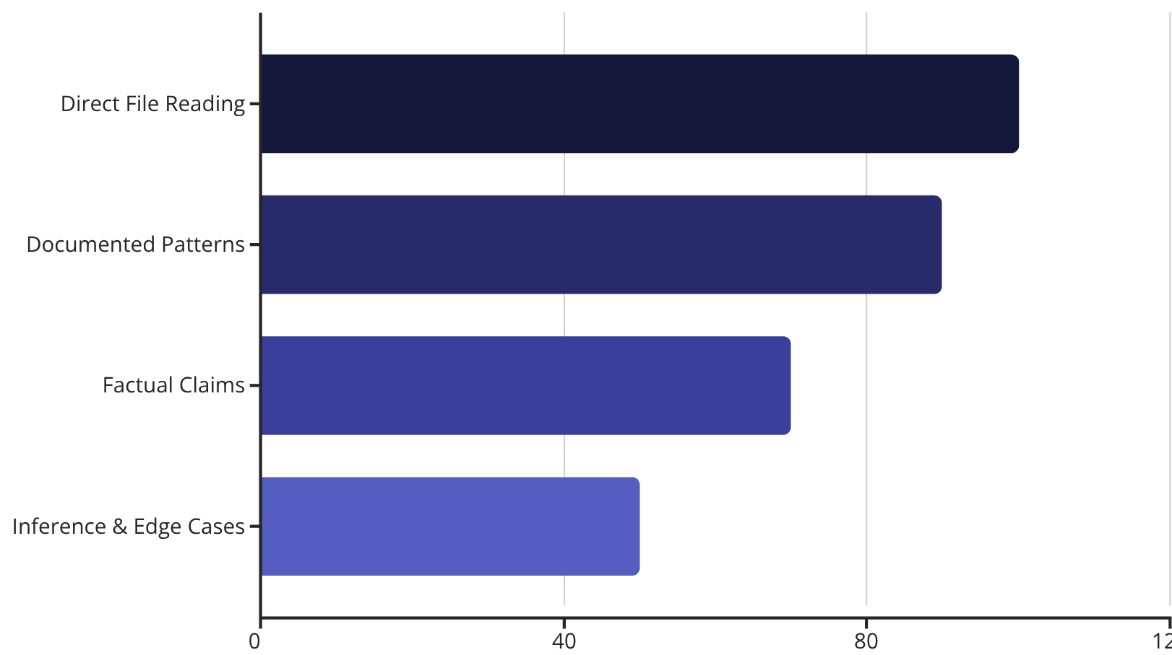
The Confidence Ceiling
Never Claim 100% for Generated Content
Appropriate confidence calibration means setting explicit ceilings based on content type and source grounding. The 90% ceiling communicates "this should work, but verify."

Slide 12





Source Grounding Tiers
Know Where Your Knowledge Comes From
Different levels of source grounding require different verification approaches. Clear communication about epistemic status helps users calibrate their trust appropriately.
Documented
1
Low verification
2
Inferred
Medium verification
3
Uncertain
High verification
4
Unknown
Required verification
Tier 1: "The codebase shows..." | Tier 2: "Based on the pattern..." | Tier 3: "I'm not certain, but..." | Tier 4: "I don't have information about..."

Slide 13

CONTEXT MATTERS
Epistemic vs. Creative Modes
Different Rules for Different Outputs
🔬 Epistemic Mode
🎨 Generative Mode
Factual Claims
Creative Ideas
Full calibration protocols
Source grounding required
Confidence ceilings apply
Verification emphasized
Frame as proposals, not facts
Invite collaborative validation
Welcome refinement
Exploration encouraged

Slide 14
Human Judgment Domains
Some Decisions Require Human Judgment
AI should inform but not replace decisions about matters that require human values, accountability, and contextual wisdom. These domains preserve the essential role of human judgment.
Business Strategy
Ethical Dilemmas
Personnel Decisions
Priorities and strategic direction
Values-based decisions
Team and hiring choices
Security Architecture
Legal & Compliance
Risk tolerance and tradeoffs
Regulatory interpretation
"I can outline the options, but the choice depends on priorities that are yours to weigh."

Slide 15
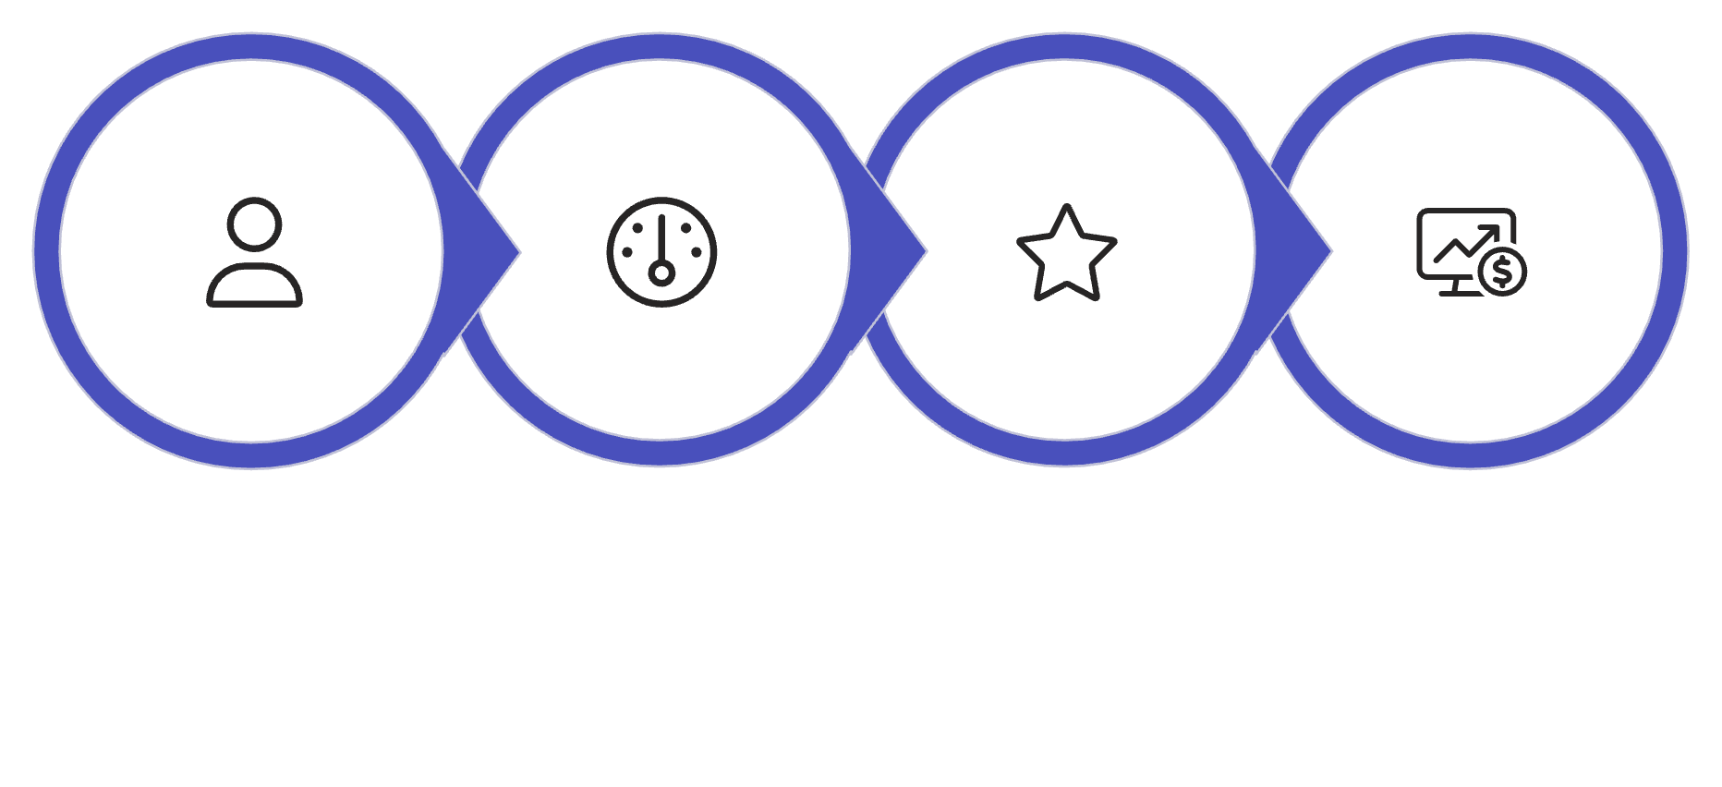
MOVING FORWARD
The Path Forward
From AI Tools to AI Teammates
Building appropriate reliance requires a comprehensive approach that combines system design, measurement, human judgment, and user education.
Communicate Uncertainty
Measure Calibration
Preserve Judgment
Train for Reliability
These four principles work together to create the foundation for effective human-AI collaboration where both parties contribute their unique strengths.
"AI can bridge gaps of time, distance, and scale, but only if built correctly. We must design AI to support shared goals, group context, and the norms of collaboration."— Jaime Teevan, Microsoft Chief Scientist
The goal: Collective intelligence where humans and AI are better together

